Slide 1
Technology, Organization and Management
Concept of Technology
Approaches to Technology and Organization
Social Networking
Use of Technology in People Management
Santosh Bhandari
Roshan Bhandari
Nayan Pathak

Slide 2

Concept of Technology
Approaches to Technology and Organization

Slide 3

What is Technology?
Technology plays a crucial role in fueling efficiency and connecting people across the globe. It's the driving force behind productivity, innovation, and the advancement of organizations.
It is the advancement in ways or principles of doing things to ensure better productivity and profitability.
1
Applying Scientific Knowledge
2
Tools and Processes
The use of tools and processes to simplify life and enhance efficiency.
Utilizing scientific principles for practical purposes.
3
Examples
Illustrated by computers, communication devices, and medical equipment.

Slide 4
Technology and Organizations
Technology's Influence
Organizational Impact
Examples
Adapting to and steering technology development and usage.
Manifested through automation, data analytics, and remote work platforms.
Impacting organizational structure, work processes, and decision-making.

Slide 5
Different Approaches to Technology in Organizations
1
Uncertainty and Predictability
Technology's impact on the predictability or uncertainty in organizational environments.
2
Technology as a System
Analyzing technology as a whole and considering its components and interactions.
3
Stability and Change
The role of technology in driving change or maintaining stability within organizations.

Slide 6



The Future of Technology and Organizations
AI and Automation
Remote Work and Digital Divide
The Human Touch
Increased automation may lead to job displacement and ethical concerns.
Striking a balance between technology and human values, well-being, and collaboration.
New work models bring the risk of inequalities and isolation.

Slide 7

Social Networking and its Importance in Business
Welcome to our presentation on social networking in business. In today’s fast-paced world, social networking has become an essential component of any successful business strategy. Let's dive in!

Slide 8

The Definition of Social Networking
1
Connecting People Online
2
Building Relationships
Social networking involves creating and maintaining online profiles, and using them to connect with other people who share similar interests.
Social networking platforms make it easy to find and communicate with new people, build relationships, and stay in touch with current contacts.
3
Sharing Information
Through social networking, people can share information about their personal and professional lives, as well as their interests and opinions.

Slide 9


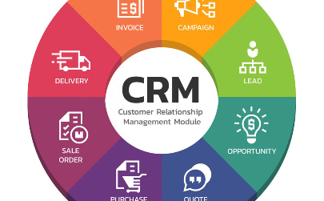
The Importance of Social Networking in Business
Improved Communication and Collaboration
Increased Visibility and Brand Awareness
Enhanced Customer Relationship Management
Social networking platforms help businesses broaden their audience and reach new customers.
Social networking enhances communication and collaboration between colleagues, partners, and customers.
Social networking provides a more direct and personal way for businesses to connect with their customers and provide better customer service.

Slide 10

Types of Social Networking
Online Social Networking Platforms
Offline Social Networking Events
Examples include LinkedIn, Facebook, Instagram, and Twitter.
Examples include conferences, meetups, and networking events.
Professional Associations
Examples include trade groups and industry associations.

Slide 11

Case Study: Use of Social Networking in Mechi Campus
Background: Mechi Campus, an educational institution, recognized the pivotal role of social networking in improving student engagement, fostering community spirit, and enhancing communication.

Slide 12
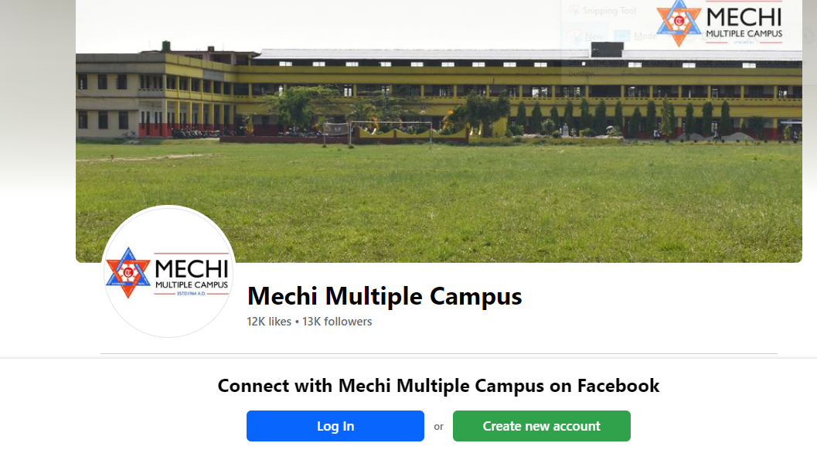
1
Social Media Presence
Mechi Campus established a social media presence on platforms like Facebook.
2
Collaborative Event Promotion
MMC promote various events, workshops, and activities through shared content on social media platforms.
3
Campus Student Spotlights
Featuring student spotlights that showcase achievements and contributions from students across different campuses, fostering a sense of unity and pride.
4
Announcements and Updates
Ensuring a unified approach to disseminating important announcements, updates, and emergency information through social media channels.

Slide 13
Outcomes of Mechi Campus Social Networking Strategy
Enhanced Student Engagement: Students interacted and supported each other's activities on social media, fostering a sense of unity.
Increased Inter-Campus Event Attendance: Cross-promotion of events led to higher attendance, creating a stronger campus community.
Improved Inter-Campus Communication: Social media facilitated the exchange of ideas, experiences, and information among students from different campuses.
Diverse Community Building: Featuring students from multiple faculty built a diverse and inclusive online community.
Data-Driven Decision Making: Polls and surveys provided insights for informed decision making across campuses.
Enhance college popularity.
In conclusion, Mechi campus strategic use of social networking significantly contributed to improved student engagement, communication, and community building.

Slide 14
The Risks of Social Networking in Business
Privacy and Security Concerns
Reputation Management
Information Overload
With the overwhelming amount of social media content, it can be challenging to focus on important messages and information.
Social networking can expose sensitive business information or personal data of employees, increasing the risk of cyber-attacks.
Negative comments, feedback, or reviews can hamper brand reputation and undermine the trust of customers.

Slide 15

Implementing Social Networking in Business
1
Developing a Social Media Strategy
Define your business goals, identify your target audience, and choose the right social networking platforms. Develop a comprehensive plan for content, promotion, and engagement.
2
Choosing the Right Social Networking Platforms
Identify the social media platforms that are relevant to your business and your goals. Focus on quality content, measurable results, and engagement with your followers.
3
Employee Training and Guidelines
Ensure employees are trained on the company's social media policies, best practices, and guidelines for appropriate behavior online. Encourage social networking activities that align with business goals.

Slide 16
Conclusion
1
Adopt Social Networking for Business Growth
2
Create a Strong Social Media Strategy
3
Overcome Risks and Challenges
Choose the right social networking platforms, train employees, and ensure appropriate behavior online to mitigate risks and overcome challenges.
Social networking is an important tool to grow your business and connect with the right people.
Develop a comprehensive plan to leverage social media to grow your business and enhance your brand.

Slide 17

The Power of Technology in People Management
Discover how technology is revolutionizing the way organizations manage their employees and maximize their productivity.
NP
by Nayan Pathak

Slide 18

What the heck is people management?
Definition
Importance of effective people Management
People management involves overseeing and guiding individuals within an organization to maximize their contributions and achieve common goals. It encompasses various aspects like recruitment, training, performance evaluation, and employee relations.
Effective management of people leads to improved productivity, higher employee satisfaction, lower turnover rates, and better overall organizational performance.

Slide 19

Benefits of Technology in People Management
1
Enhanced Efficiency 🚀
2
Data-Driven Insights 📊
Technology automates administrative tasks, reducing manual workload and allowing HR personnel to focus on strategic initiatives.
Technology enables HR professionals to collect and analyze data to make informed decisions and improve performance.
3
Improved Communication 🌐
Technology tools facilitate seamless communication between employees, managers, and HR, fostering collaboration and engagement and better feedbacks.

Slide 20
Key areas of people Management improved by Technology
Recruitment and Hiring
Training and development
Performance management
Technology has revolutionized recruitment through online job portals, applicant tracking systems, and AI-powered tools for resume screening, making the hiring process more efficient and data-driven.
E-learning platforms, webinars, and skill-building apps provide employees with flexible and accessible learning opportunities, enhancing their skill sets and knowledge base.
Automated performance evaluation software allows for consistent and fair assessments, while feedback tools facilitate regular communication between managers and employees.

Slide 21

Challenges and Risks of Using Technology in People Management
1
Privacy and Security Considerations
2
Implementation and Integration Challenges
3
User Experience and Accessibility
Ensuring technology is user-friendly, accessible, and inclusive for all employees.
Protecting sensitive employee data and ensuring compliance with data protection regulations.
Successfully deploying and integrating new technology, including user adoption and change management.

Slide 22
Some of top companies using Technology in HR management
Microsoft
Google
Salesforce
Amazon
Uses AI driven tools for performance evaluations of the employee. Through continuous feedback mechanisms, and data analytics, they personalize their employee development plans.
Google uses ‘Peoples Analytics’ to utilize data and analyze them to understand their employee behavior patterns.
Implements VR based training program for its employees. Using VR they simulate the real world scenarios to train their workforce employees effectively.
Uses AI and ML algorithms to screen job applications. It efficiently filters candidates based on skills, exp, qual, streamlining the hiring process.

Slide 23




Embrace the Future of HR using Technology
AI and predictive analysis
predicting employee behavior, Performance patterns, Making proactive decision
Remote work
Adapting management practices for remote teams, Leveraging technology for seamless collaborations
VR & AR
Utilizing VR and AR for immense training experience and innovative collaborations methods

Slide 24
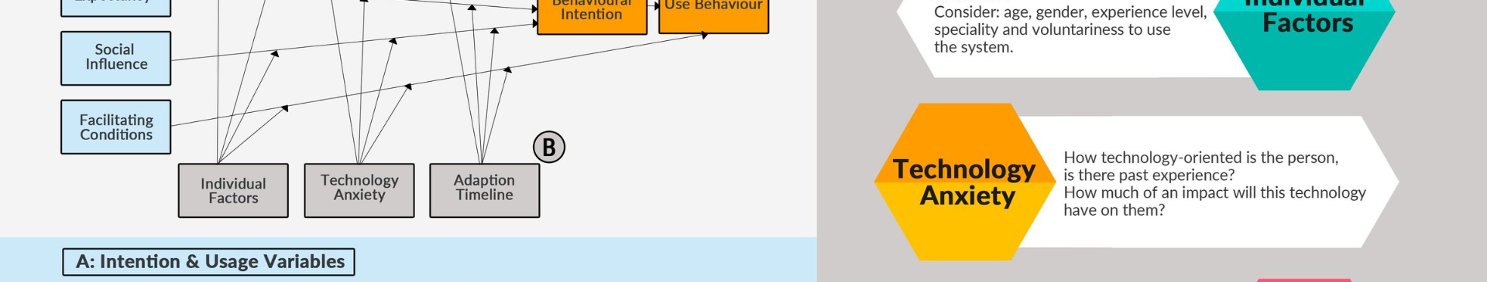
The conclusion:
Foster seamless communications
Stay adaptable and future ready
Boost efficiency
Make data-driven decisions
Enhance employee engagement
Achieve cost savings and optimizations

Slide 25

